Slide 1
Introduction to TouchDevelop
Lesson 1 – Turtle Power

Slide 2
WALT (We Are Learning To)
To code (using TouchDevelop)
WILF (What I’m Looking For)
Control motion by specifying the number of steps to travel, direction and turn.
Specify types of rotation giving the number of degrees
Combine the use of pens with movement to create interesting effects.

Slide 3
Getting started
Click here to get started: https://www.touchdevelop.com/evzp
Tap “tweak it”

Slide 4
Moving your Turtle
The turtle has four basic moves: forward, back, left turn and right turn.
The turtle drawings template already has a little bit of code to get you started.
Tap the run button to see what the code does.

Slide 5
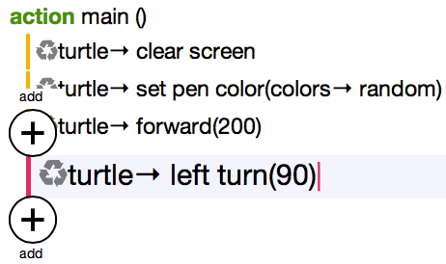
Drawing a square
First let's tell the turtle to move forward 200 steps.
Go to ▷ main()
Tap on the last line of code
Tap on the + button below the last line

Slide 6
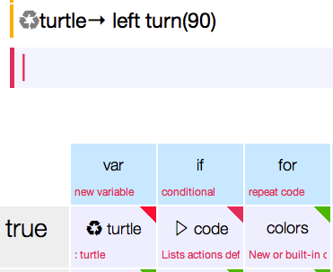
Drawing a square continued 1…
Tap on the symbol in the lower right keyboard
Tap on the button
Help: If you can’t see the forward button, click on the blue arrow

Slide 7
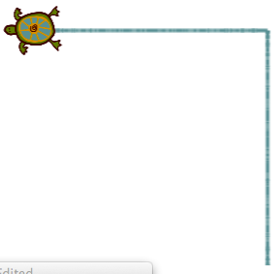
Drawing a square continued 2…
Your code should look like this:
Use the number pad to change 0 to 200
Run your script to see what happens

Slide 8
Drawing a square continued 3…
The next step is to turn your turtle 90 degrees to the left.
Go back to ▷main()
Tap on the last line of code
Tap on the in the lower right keyboard.
Tap on left turn. If you can’t see the left turn button, click on the blue arrow button
Use the number pad to change 0 to 90
Run the script to see what happens

Slide 9
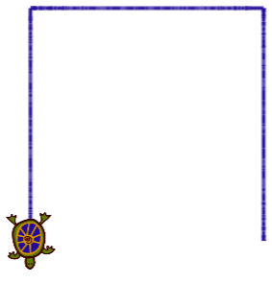
Drawing a square continued 4…
Add the code to move the turtle forward 200 steps.
Run the script to see what happens.

Slide 10
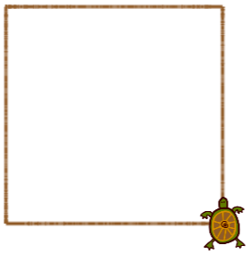
Drawing a square continued 5…
Add the code to turn the turtle left 90 degrees and move forward 200 steps one last time.
Add one more left turn so that turtle finishes where it started.
Run the script to see what happens.
Congratulations! You have drawn a square.

Slide 11
TouchDevelop Turtle Challenge
Customizing your Turtle

Slide 12
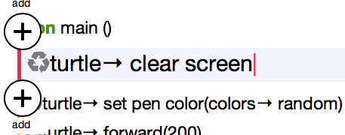
Changing the Pen Size
Let's customize your turtle!
The first thing you can change is the size of the pen:
Go to ▷main()
Tap on the first line of code
Tap on the + button below the line you have just selected

Slide 13
Changing the Pen Size continued…
Add a new line at the beginning of your script to change the thickness of the pen to 5.
Tap on the symbol in the lower right keyboard
Tap on set pen size. If you can’t see the set pen size button, click on the button.
Use the number pad to change 0 to 10.
Run your script to see what happens.

Slide 14
Changing the Pen Colour
The sample code already contains the command to change the pen colour. Did you spot it?
Find the line containing the code “set pen color”
Tap the word → random so that it is highlighted in green:

Slide 15
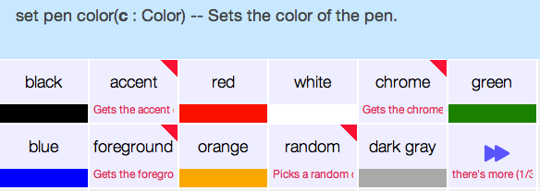
Changing the Pen Colour Continued…
Tap the cut button.
Choose a new colour from the lower right keyboard.

Slide 16
Pen Up or Pen Down?
Sometimes you may want to move the turtle without it drawing a line, just like lifting the pen off the page.
To lift the pen up use the code:
To place then pen down use the code:

Slide 17
TouchDevelop Turtle Challenge
Fun with Loops

Slide 18
Fun with Loops
Making the turtle create a square was pretty easy but also involved typing a lot of code! Thankfully, there is a better way! Instead of re-typing the same code 4 times, we can repeat it 4 times using a for loop.
Go back to ▷main()
Delete all the code by selecting each line and tapping cut.
Add a new line.
Tap on for in the blue section of the lower right keyboard.

Slide 19
Fun with Loops Continued 1…
Enter 4 using the number pad
Tap on do nothing under the for command (This is where the code that needs to be repeated goes)
Add the following 2 lines of code:

Slide 20
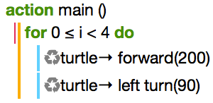
Fun with Loops Continued 2…
Your code should now look like this:
Run your script to see what happens.
Can you explain what the code is doing?
Now let's change some of the values!

Slide 21
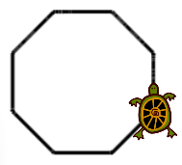
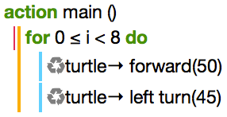
Fun with Loops Continued 2…
Go back to ▷main()
Change the 4 in the for loop to an 8
Change 200 in the forward command to 50
Change 90 degrees in the left turn command to 45 degrees.
Run your script to see what happens.
What other shapes can you make?

Slide 22
TouchDevelop Turtle Challenge
Turtle Challenge

Slide 23
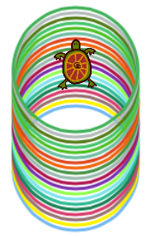
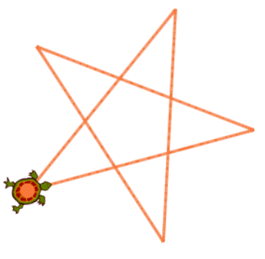
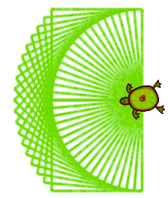
Let's get creative
Now try making your own shapes! Here’s some ideas to get you started:

